Slide 1
A data-driven approach to predict the success of bank telemarketing
By - Prakhar Bansal
University Roll No. – 2013659
Section – DS
B.Tech(CSE)

Slide 2
About the Problem: We are given the data of direct marketing campaigns (phone calls) of a Portuguese banking institution. The classification goal is to predict if the client will subscribe a term deposit (target variable y).
Data Set-
Here I will be using the data set of Bank Marketing Campaign to Predict if the client will subscribe to direct marketing campaign. There were four variants of the datasets out of which we chose “ bank-additional-full.csv” which consists of 41188 data points with 20 independent variables out of which 10 are numeric features and 10 are categorical features.

Slide 3
Type of Machine Learning problem: This is a binary classification problem. Our two classes are “yes” denoting that the customer subscribed to a term deposit, and “no” denoting that the customer did not subscribe.
Exploratory Data Analysis:
When working on a new dataset in order to take intelligent action, you need to understand your data. Exploratory data analysis (EDA) allows us to develop the gist of what our data may look like and what kinds of questions can be answered by them. EDA is important because it allows the explorer to make critical decisions about what is interesting to pursue and what probably isn’t worth following up on and thus building a hypothesis using the relationships between variables. EDA helps us to gain insights and help us understand the correlation between the independent variables and target variables.

Slide 4
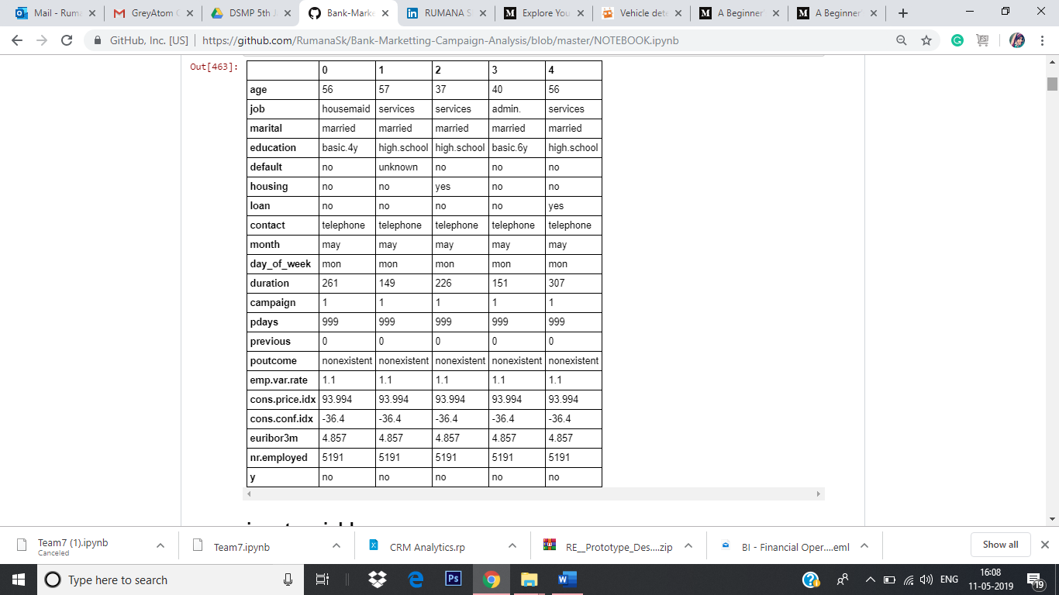
Getting to Know about Data: At the very first of Exploratory Data Analysis, we want to start understanding the data quickly, so here we use df.head(), df.describe() and df.shape().
Initial Findings of The Data:
There are total of 41188 records
10 numeric attributes
10 are categorical variable
6 multi valued Categorical Attributes
3 yes/no binary attributes
1 target attribute y

Slide 5
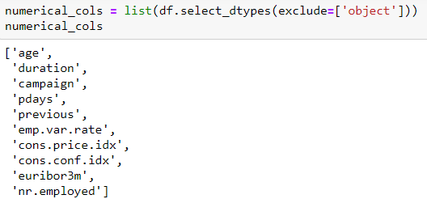
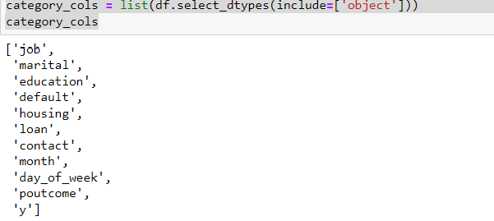
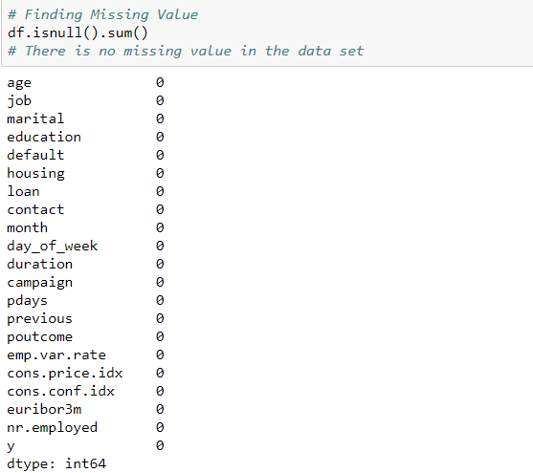

Slide 6
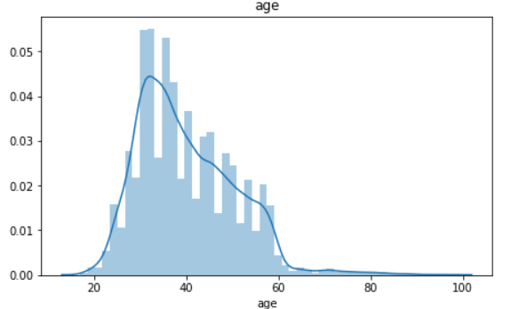
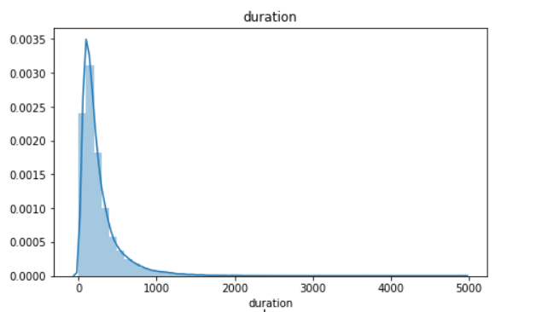
Data Visualization:
Visualising the data is an important step of the data analysis. With a graphical visualisation of the data we have a better understanding of the various features values distribution:
As we can see in the distribution, that most of the customers are in the age range of 30-40.
This seems like a powerlaw distribution where most the values are very low and very few have high values.

Slide 7
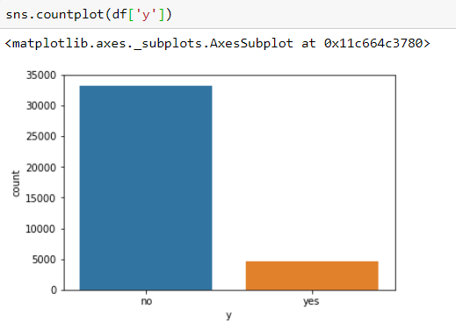
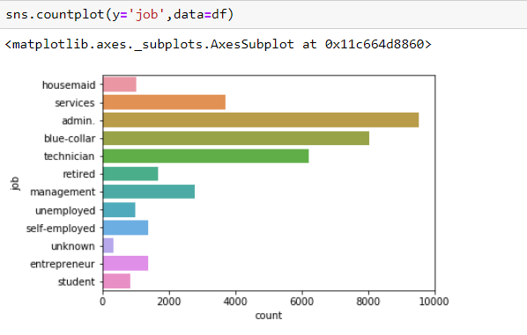
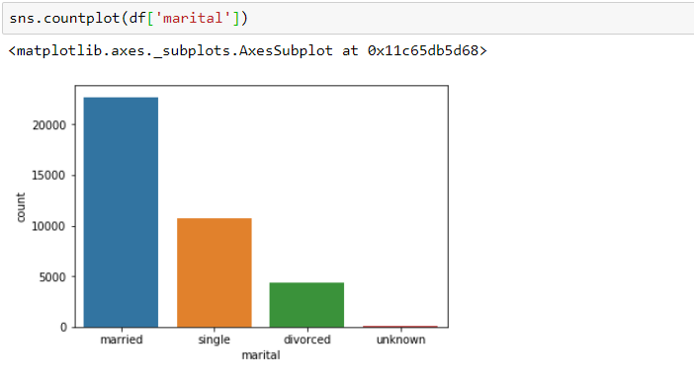
First we will look into the class distribution to see if it is a balanced data or not.
We can see from the plot that the dataset is imbalanced, where the number of negative class is close to 8 times the number of positive class.
Job:From the plot, we can see that the customers who have a job of admin have the highest rate of subscribing a term deposit
Marital: Majority of the customers are married. Followed by Single, divorced and unknown.

Slide 8
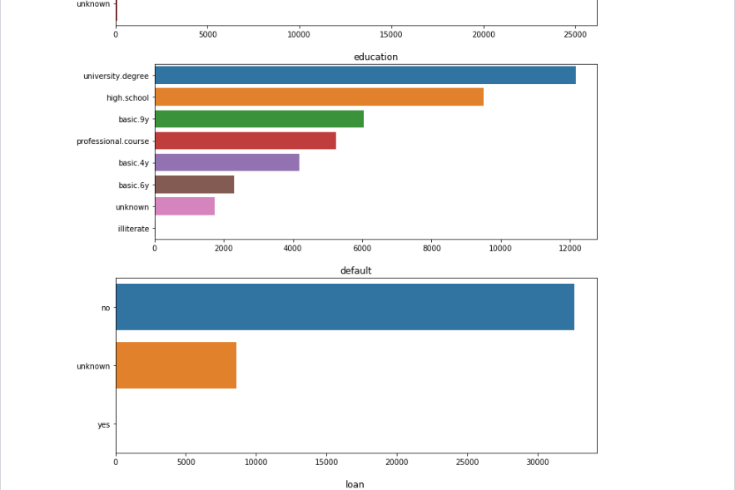
Default:
Denotes if the customer has credit in default or not. The categories are yes, no and unknown.
There is no customer with who has credit in default. Majority of the customers don't have, and the for the rest of the customers this field is unknown.

Slide 9
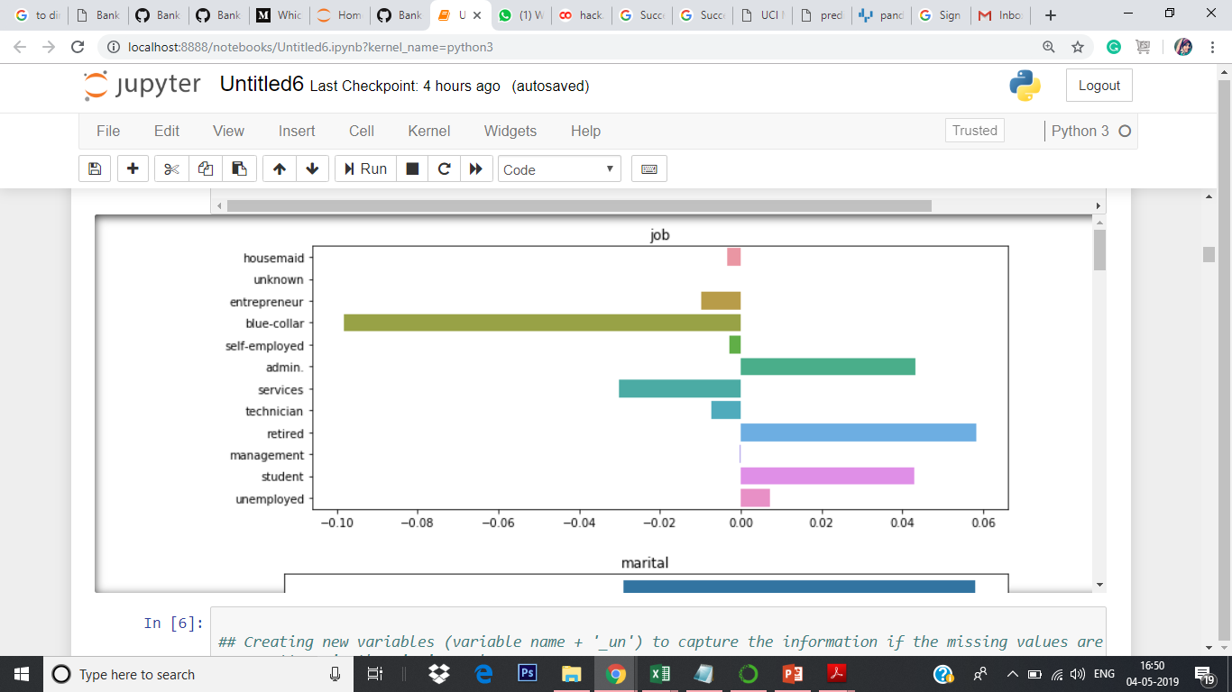
EDA
Dataset with 20 features for 41,000 clients with binary target variable.
Understanding the trends & correlation among each features.

Slide 10
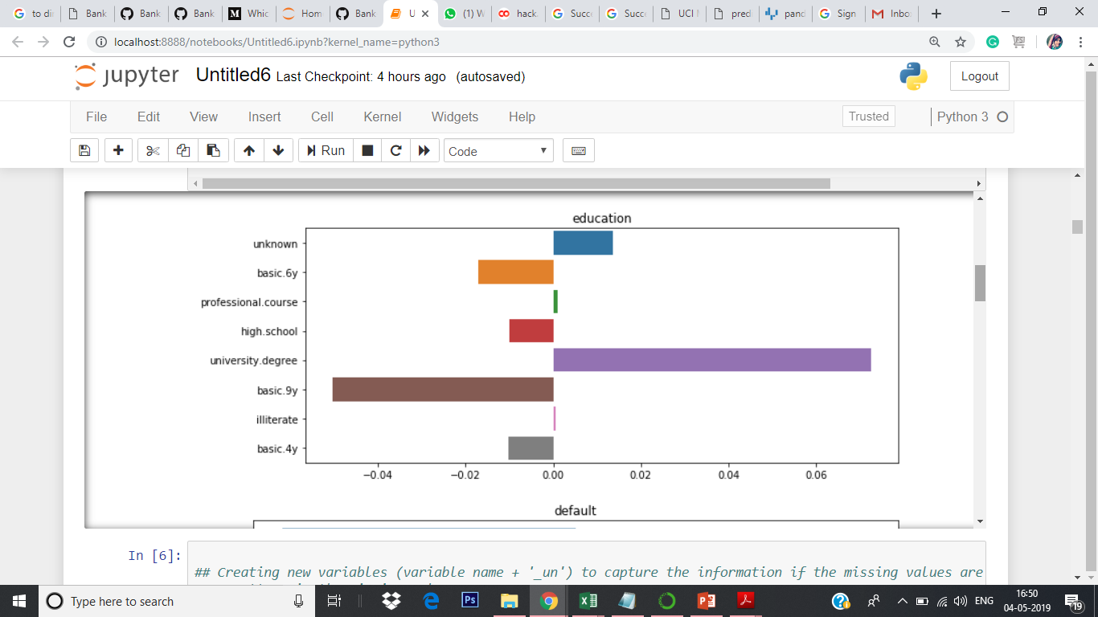
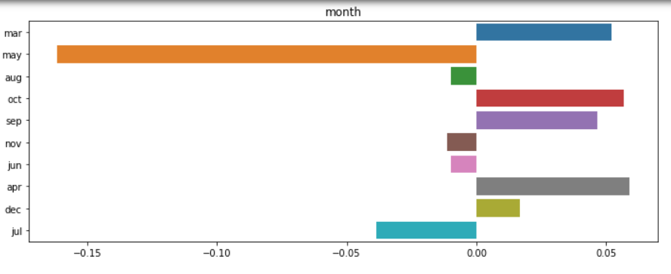
Features Comparison

Slide 11
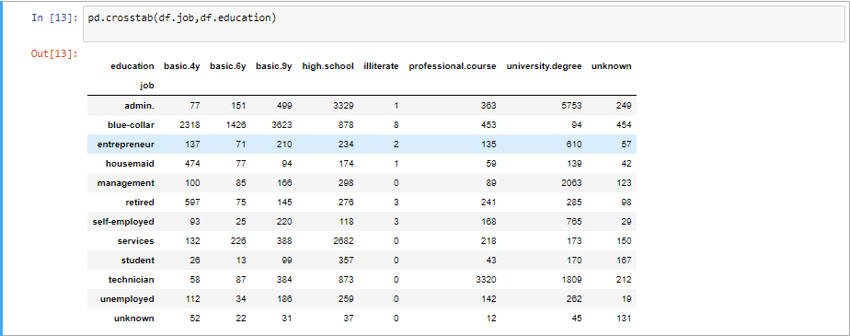
Most of the blue-collar job are having the education basic.4y, basic.6y, basic.9y
admin jobs have the highest university degree that is 5753

Slide 12
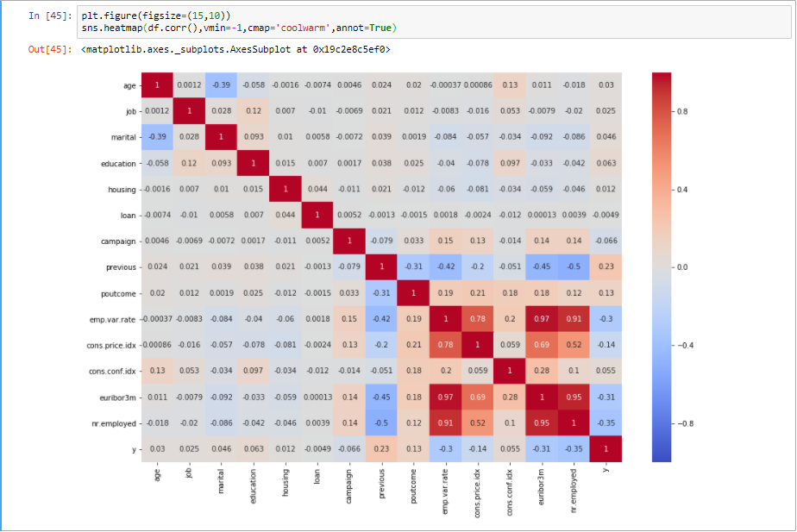
Correlation Heatmap
The emp.var.rate, cons.price.idx, euribor3m and nr.employed features have very high correlation. With euribor3m and nr.employed having the highest correlation of 0.95!

Slide 13
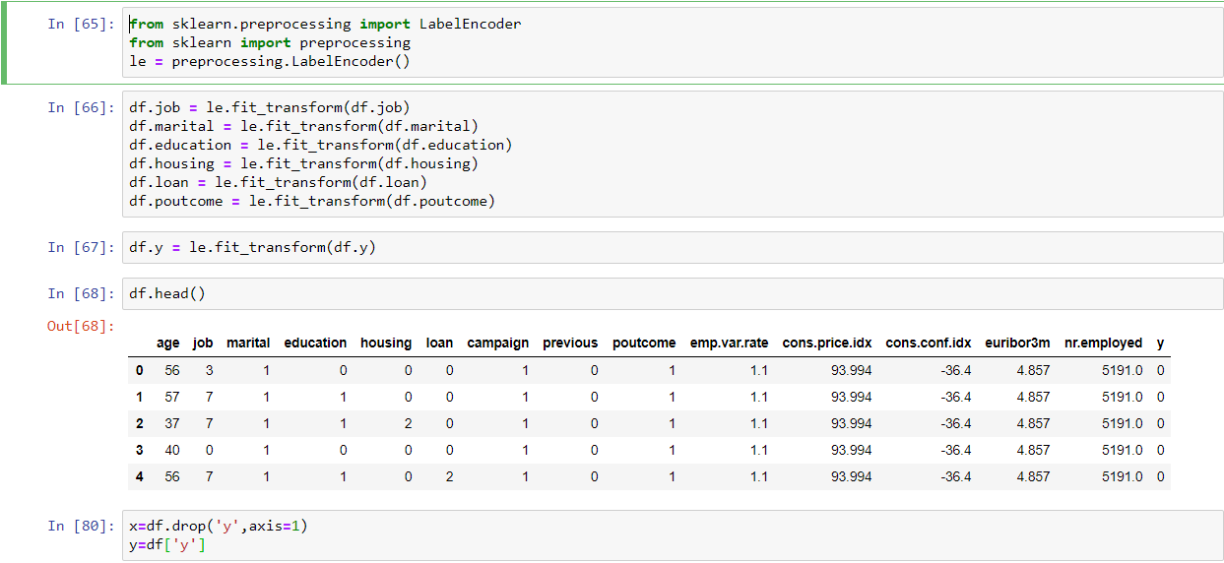
Pre Processing
Converting Categorical variable into numeric using Label Encoder

Slide 14
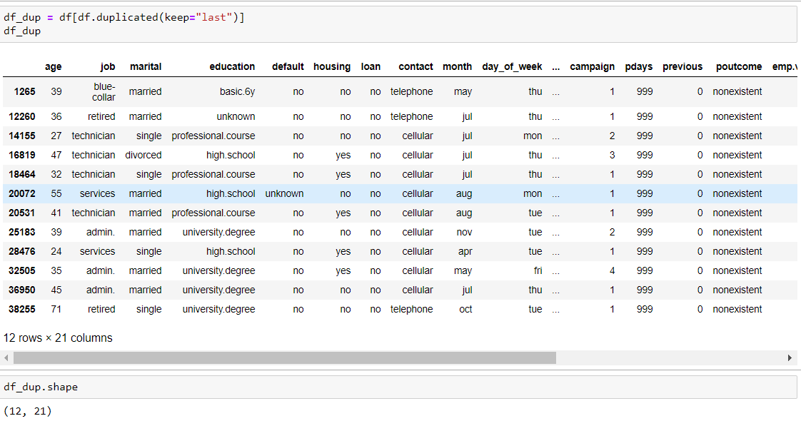
Handling Missing Values
There are unknown values for many variables in the Data set. One of the ways is to discard the row but that would lead to reduction of data set and hence would not serve our purpose of building an accurate and realistic prediction model.
Dealing with Duplicate values:
So we have 12 rows which are duplicates. We will drop these duplicate rows before proceeding furthur.

Slide 15

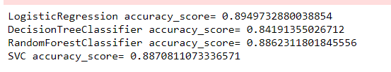
Train and Test split
Now that the data has been prepared, we are ready to train our model and make predictions. Let’s first split the data into the training and testing sets:
Building Predictive Model
We will try four classification algorithms, i.e. Logistic Regression, Support Vector Machine, Decision Trees, and Random Forest, and then compute their accuracy score choose the classifier with the highest accuracy:
Conclusion
We finally find accuracy score of 89.49% using Logistic Regression algorithm

Slide 16
Thank you

